Slide 1
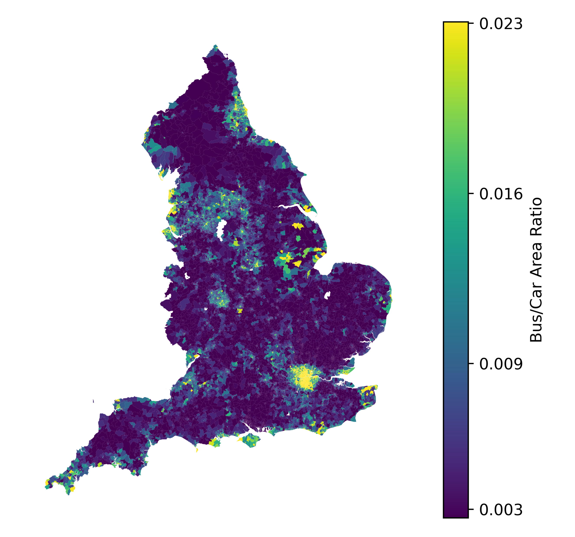
Newcastle
Liverpool
Birmingham
Bristol
London

Slide 2
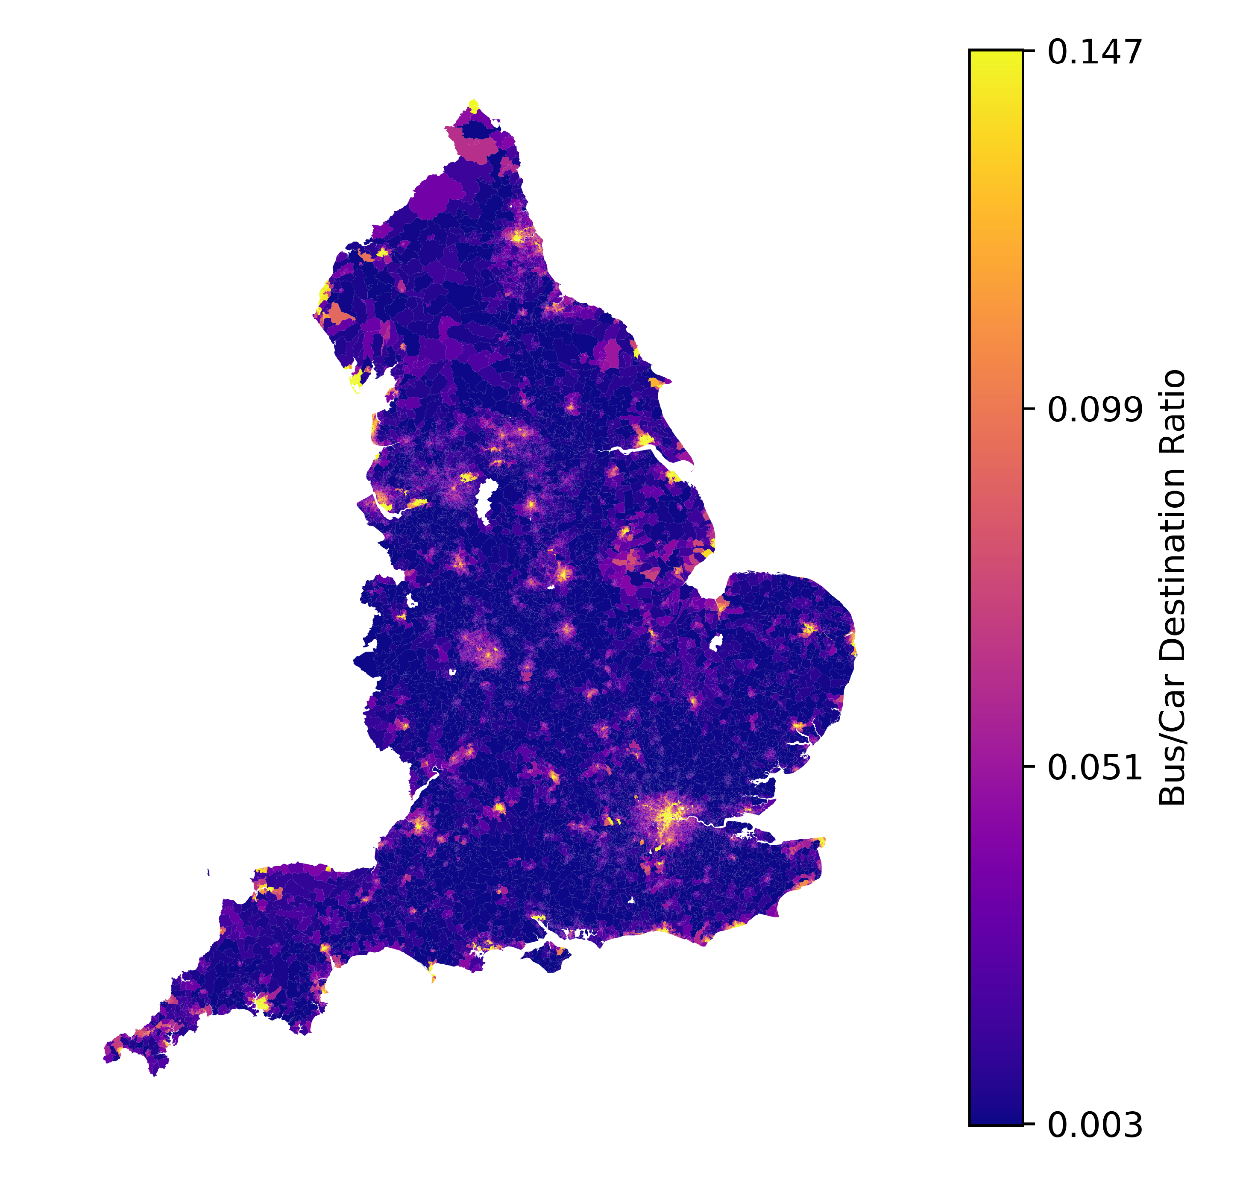
Newcastle
Liverpool
Birmingham
Bristol
London

